Slide 1
Learning intentions and success criteria
I am learning…
I can…
Camera modes and functions
How to identify appropriate modes and functions for a scene
Identify suitable camera features for a given scene
Plan the modes and functions for my Level 45 Project

Slide 2

Camera Modes & Functions
NPA Digital Media (Level 5)

Slide 3
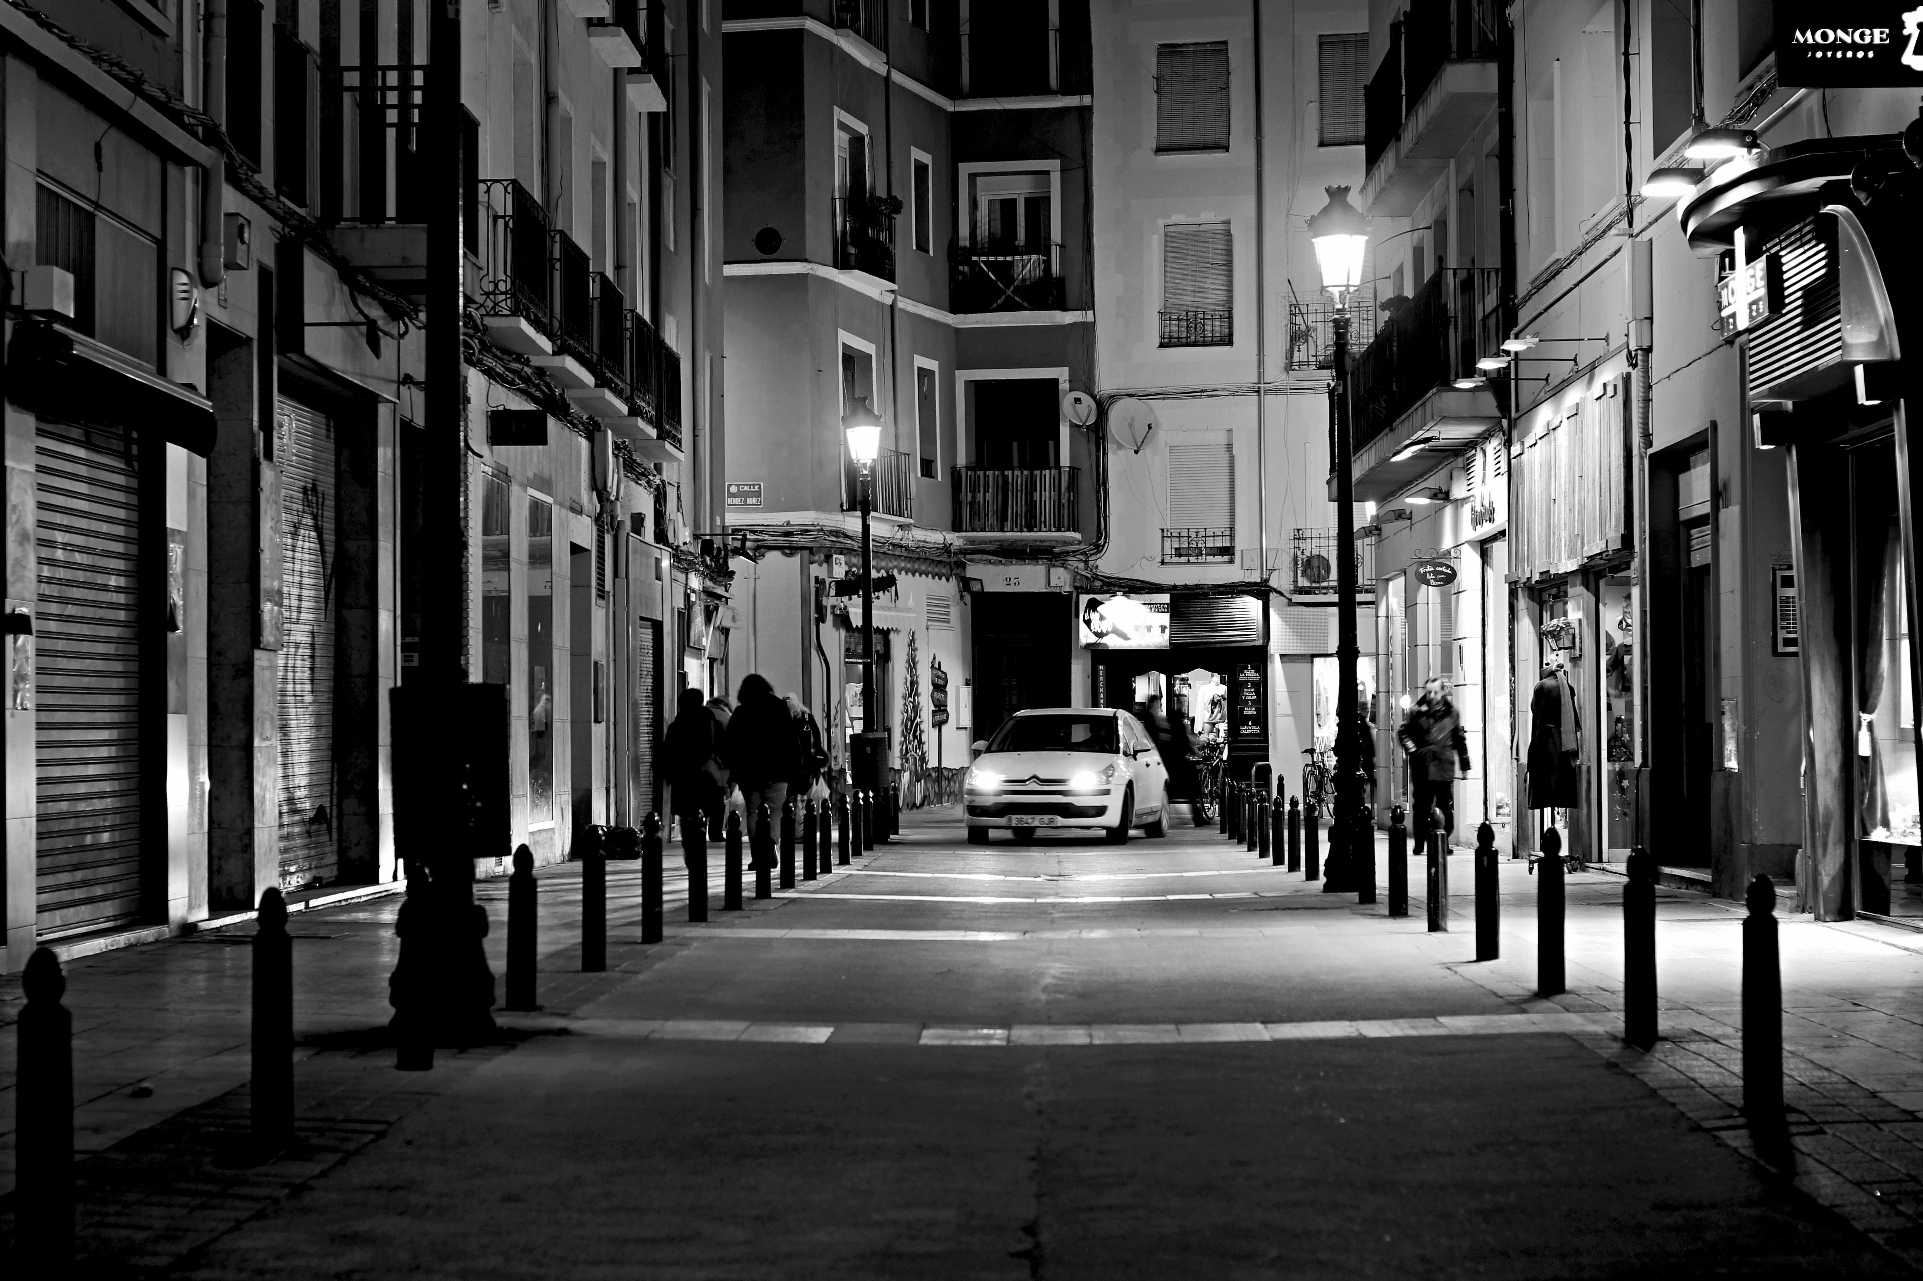

Still Image Modes
Some common still image camera modes:
Black and white
High-key
Low-key
Toy camera
Soft focus
Retro
Tilt-shift (miniature)

Slide 4
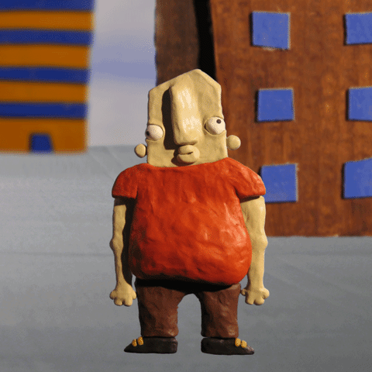
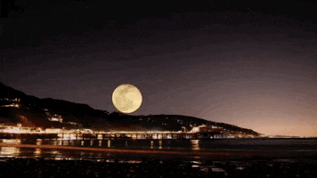
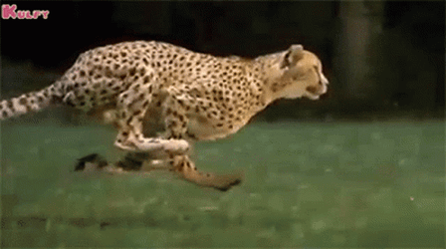
Moving Image Modes
Some common moving image camera modes:
Timelapse
Slow motion
Stop motion

Slide 5
Learning intentions and success criteria
I am learning…
I can…
Camera modes and functions
How to identify appropriate modes and functions for a scene
Identify suitable camera features for a given scene
Plan the modes and functions for my Level 45 Project

